Slide 1
NYIT, Manhattan Globe
Election coverage issue, CMA presentation, 3/12, 9 am

Slide 2
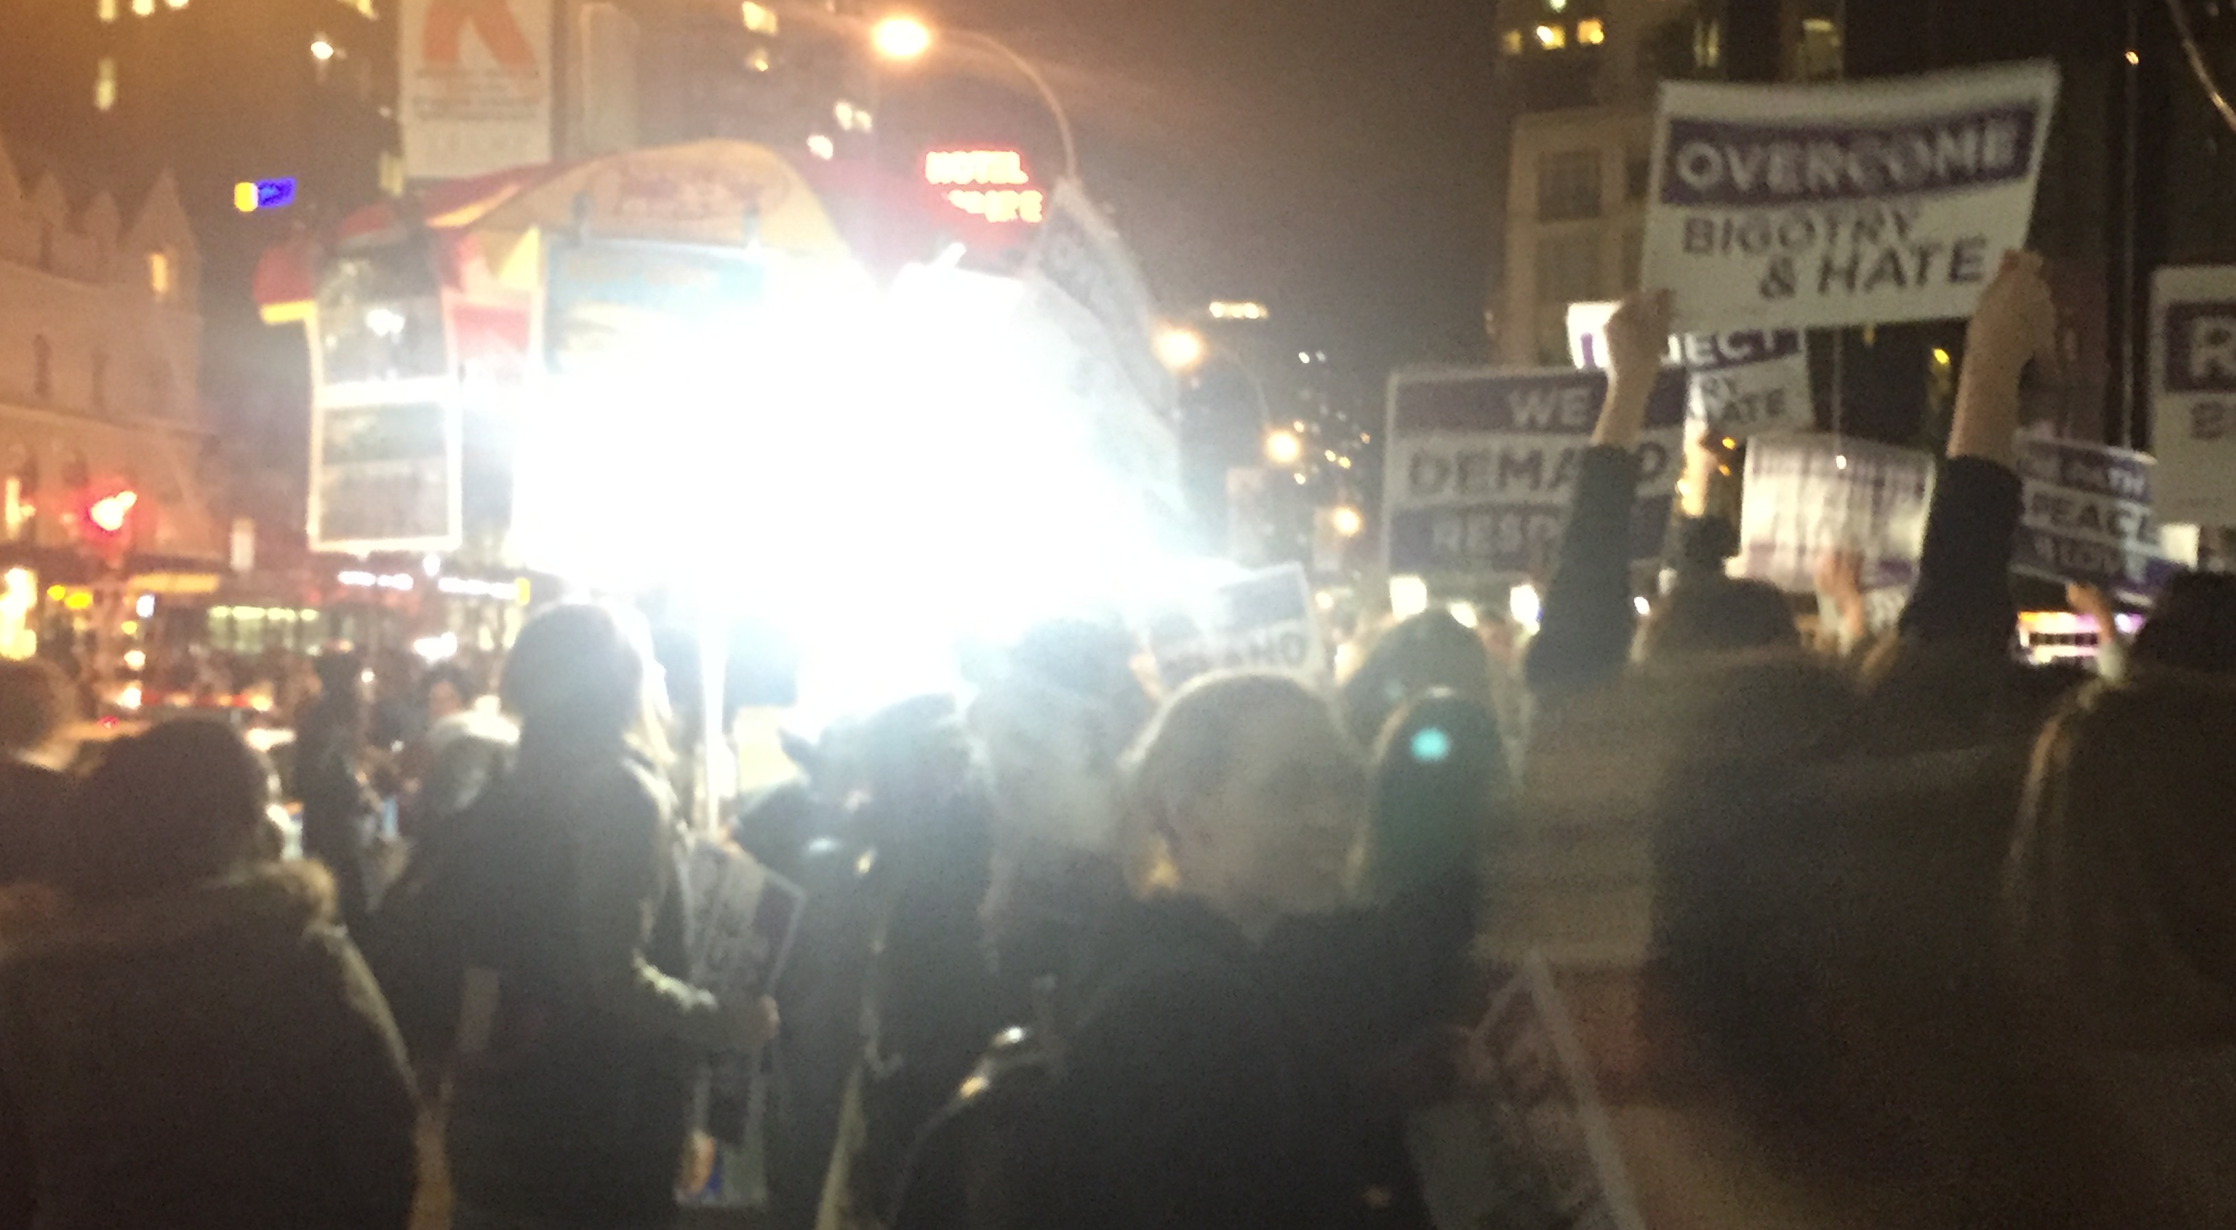
NYIT Across from Trump Hotel
Columbus Circle protest, Nov. 13, 2017 in upper right hand corner, yellow & blue squares are the NYIT logo and main building.

Slide 3
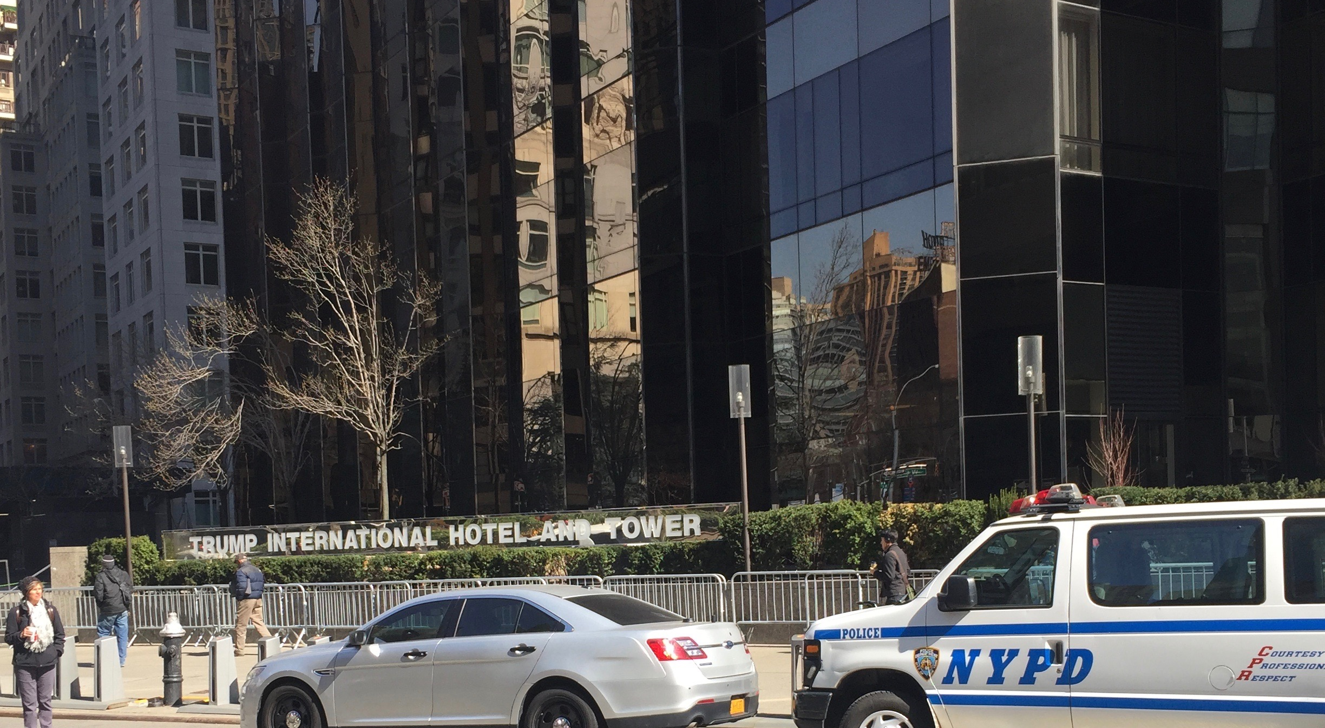
It’s quieted down a bit

Slide 4
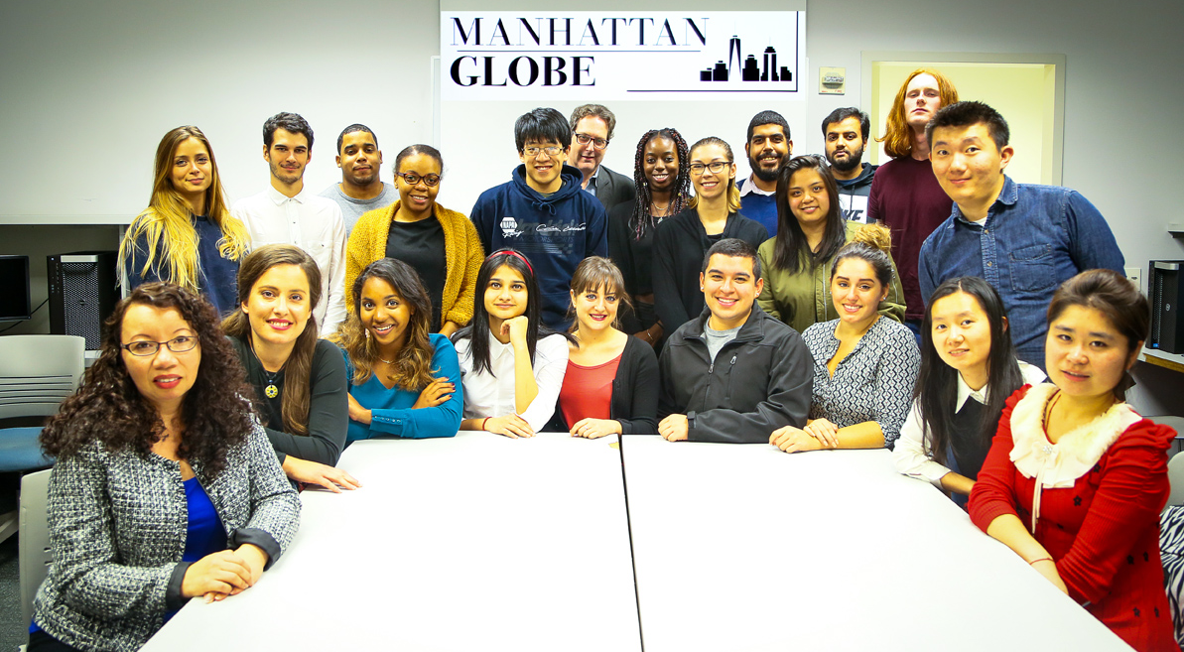
Diverse editorial staff reflects campus
Currently 7 countries represented on staff: France, Sri Lanka, China, Saudi Arabia, Jamaica, Canada, Greece

Slide 5
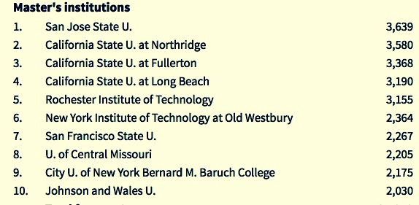
NYIT #6 in U.S. Most Intl Students
Source: Chronicle of Higher Education

Slide 6
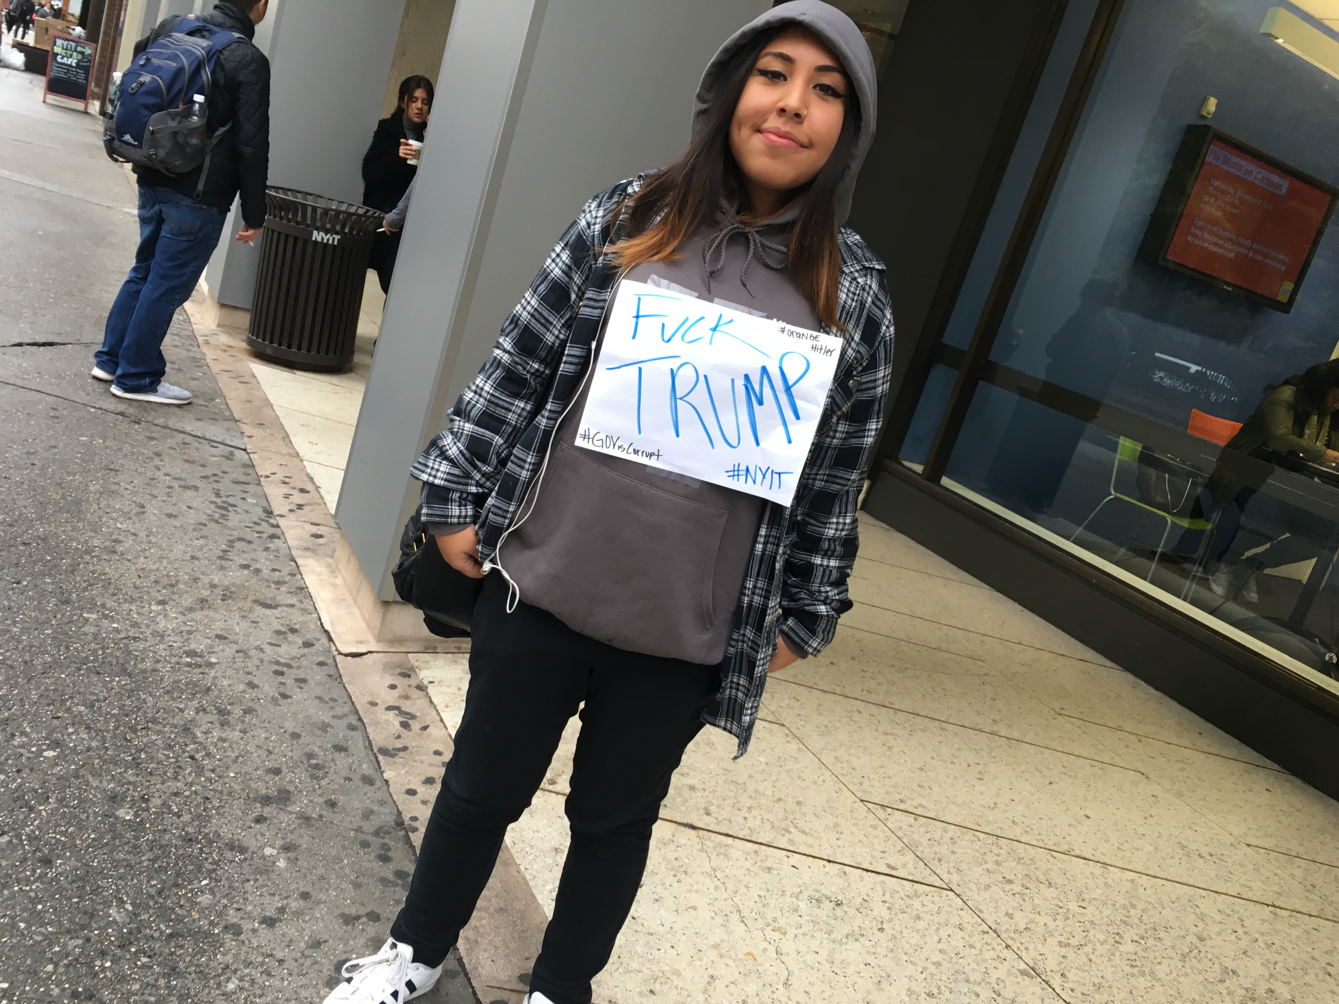
Nov. 9, 10 am in front of library
Get text from Co-Editor with this photo

Slide 7
Carefully considered the picture
Did the student know you were the co-editor of the paper and the photo could be used?
Do you know her name?
Time of the essence, I consult with the department chair from my other school, and put the Student Law Press Center on speed dial
We decide to use but ….

Slide 8
How the front page turned out

Slide 9
Reaction: “I don’t agree with this”
Didn’t know what to expect
First person who grabbed a copy as it was delivered was former Dean, who said “I don’t agree with this”
Instead of asking what exactly he doesn’t agree with, I say: “It’s a student newspaper.”
He said he appreciated that but he still disagreed, but agreed with me if we had a real campus there would be more protesters.

Slide 10
More feedback
A tenured Communication Arts faculty member commented: “You shouldn’t say ‘Fuck Trump’ on the cover. Trump has hired NYIT students.”
We obviously have a difference of opinion, and don’t get into an argument about the newsworthiness of the protest
The Globe planned to work on an article about students who worked for Trump (didn’t happen)

Slide 11
Prepare to defend decision
Photo symbolically represents what NYIT students are thinking: they fear what this presidency means for their futures
The staff was unanimous in wanting to run it
The student holding the sign was making news and exercised her right to freedom of speech
NYIT's largely international student population is fearful for the anti-immigrant posturing of Trump during the campaign and since taking office

Slide 12
More reasons why it needed to run
It’s a student newspaper, not The New York Times
I was concerned about her safety from pro-Trump supporter, which is why her face was obscured
I don't believe in prior restraint or censorship for a college newspaper
I looked at it as a bold move for The Globe to make a statement about it being an independent student voice, not a mouthpiece of the administration

Slide 13
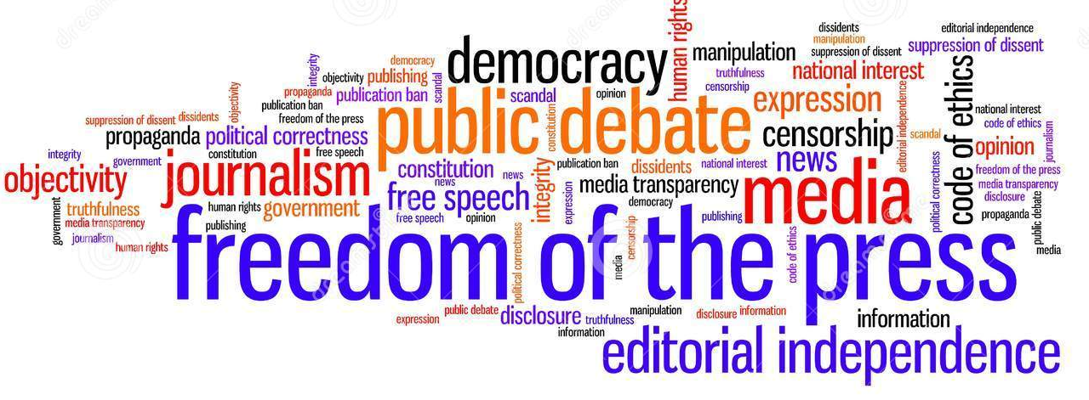
No better a story than the election for a college newspaper to exert its independence at a time like this

Slide 14
The right decision?
At a time newspapers are fighting for their existence, this photo represented an opportunity for the newspaper to be read and discussed by the intended audience: the students
I fully considered that I may receive heat, maybe even worse, but believe I made the right decision in supporting the students' decision to use the slightly altered photo
I teach my journalism students to think differently and not fall into the complacency of pack journalism largely practiced by the mainstream media that contributed to Trump getting elected

Slide 15
Protests continued @ NYIT
Manhattan Globe, issue 3, Dec. 22, 2016

Slide 16
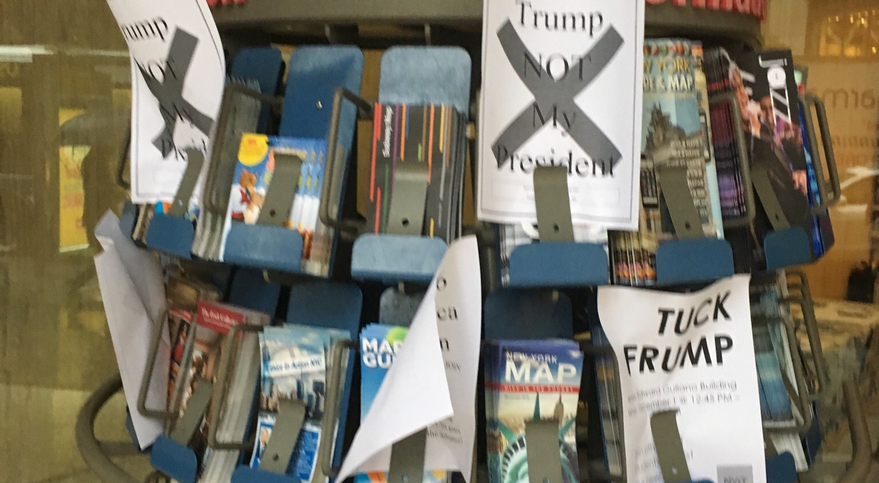
Outside NYIT Main Entrance

Slide 17
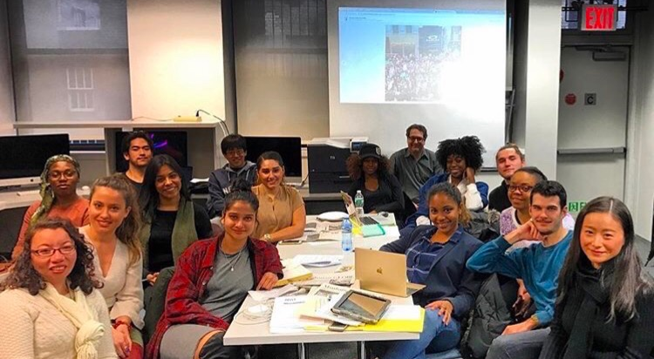
Current staff photo

Slide 18
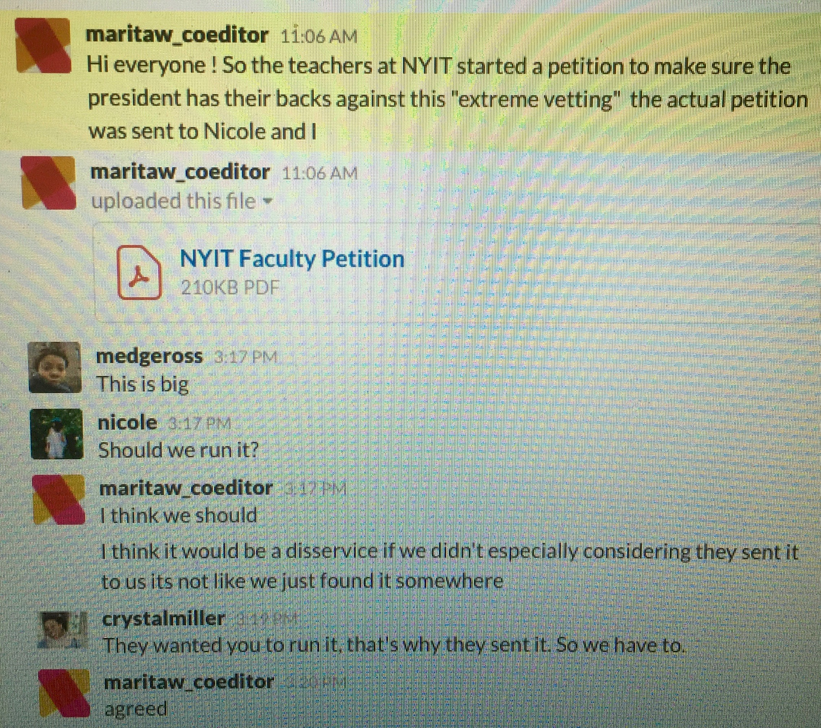
Faculty petition protesting ban

Slide 19
Tenured Faculty support sanctuary

Slide 20
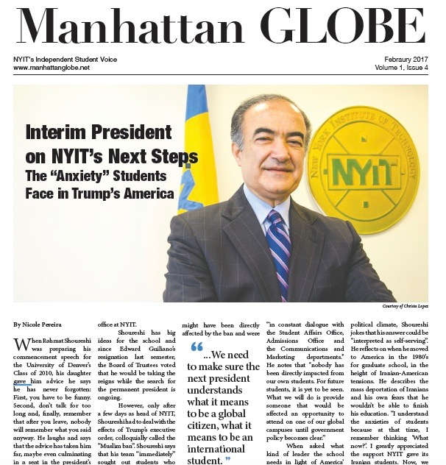
Interim President, Iranian-American
First issue of Spring 2017 semester

Slide 21
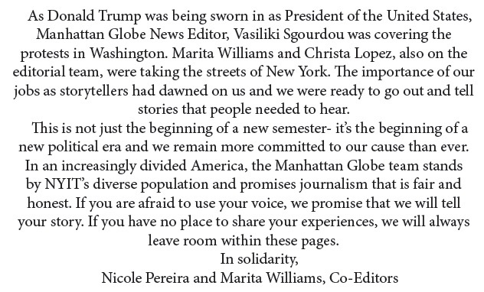
Co-Editors’ Note, February issue

Slide 22
Thanks!
Larry Jaffee, adviser, Manhattan Globe
New York Institute of Technology
Also presenting today at 12:30 pm in room Liberty 5 on “What I Learned Being a Start-Up Print Newspaper Adviser’
ljaffee@nyit.edu • 917-291-2488

