Slide 1
What I Learned Being A Start-up Print Newspaper Adviser
Larry Jaffee, March 12, 2017
CMA 2017, Sheraton, NY Times Square
12:30-1:20 pm, Liberty 5

Slide 2
New York Institute of Technology
Manhattan campus hadn’t a student newspaper in seven-plus years
I had been teaching there as an adjunct since 2013
Main NYIT campus in Old Westbury, Long Island had a student publication, the Campus Slate that was celebrating its 50th anniversary

Slide 3
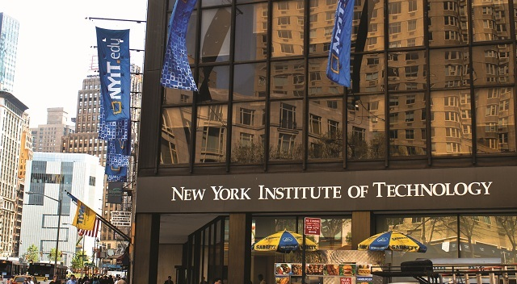
Manhattan Campus

Slide 4
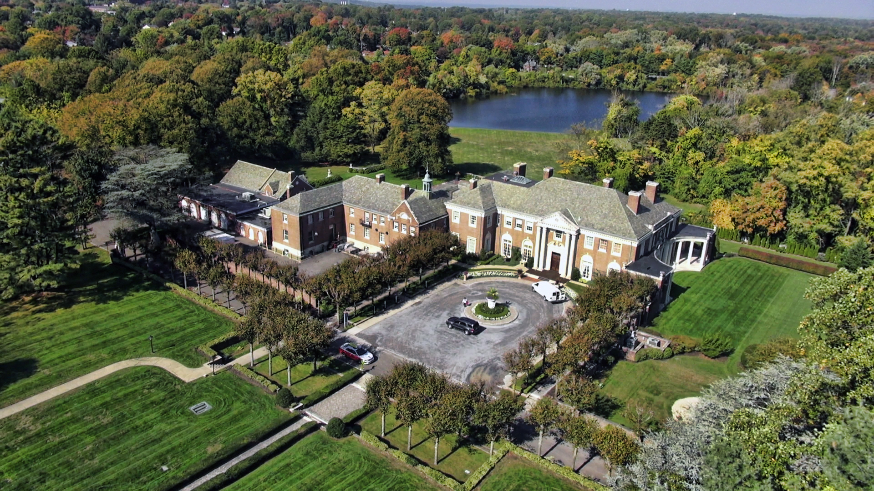
Main Campus: Old Westbury

Slide 5
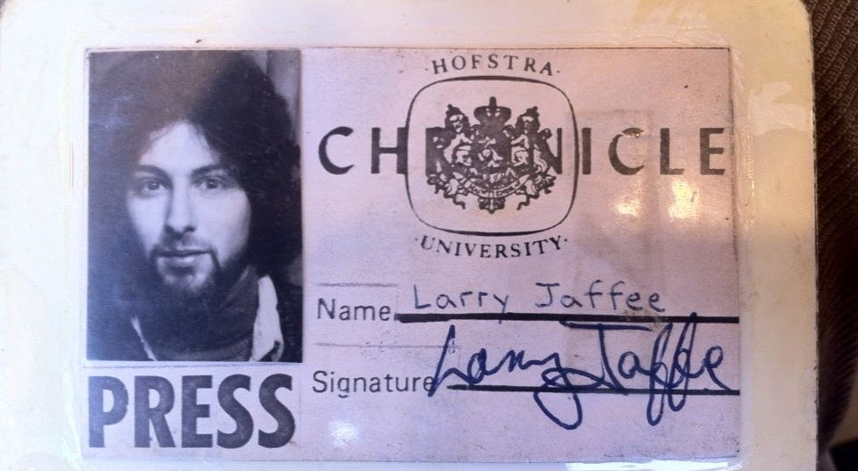
Grew up with college newspapers

Slide 6
Hofstra Chronicle
• Began writing for the weekly newspaper the first week of my freshman year in Sept. 1976
Worked my way up the arts section
Elected editor-in-chief by the staff in May ’79
Under my watch, The Chronicle was awarded the Best College Weekly by the Society of Collegiate Journalists. I realized this last year. Why didn’t I get a better job out of college?

Slide 7
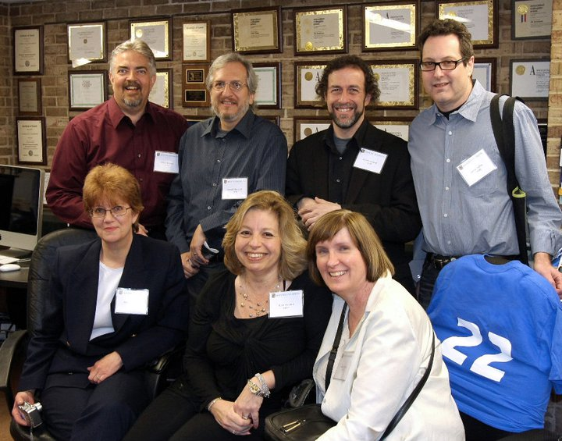
These friendships remain
Nearly 40 years later we’re still in touch
And regularly have reunions (2011 pictured)

Slide 8
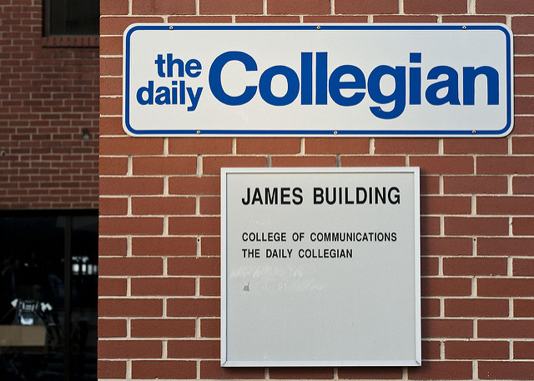
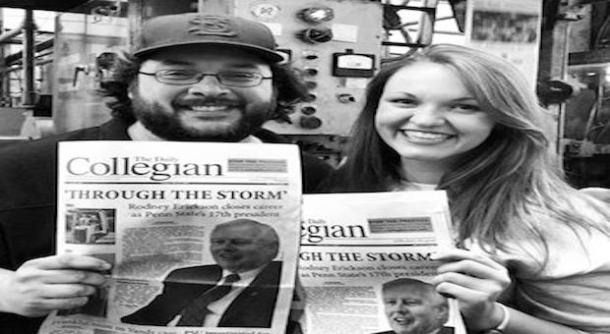
At grad school Penn State, ‘85-’86
The Daily Collegian obviously didn’t need my help
I was teaching JOUR 101 as a graduate assistant

Slide 9
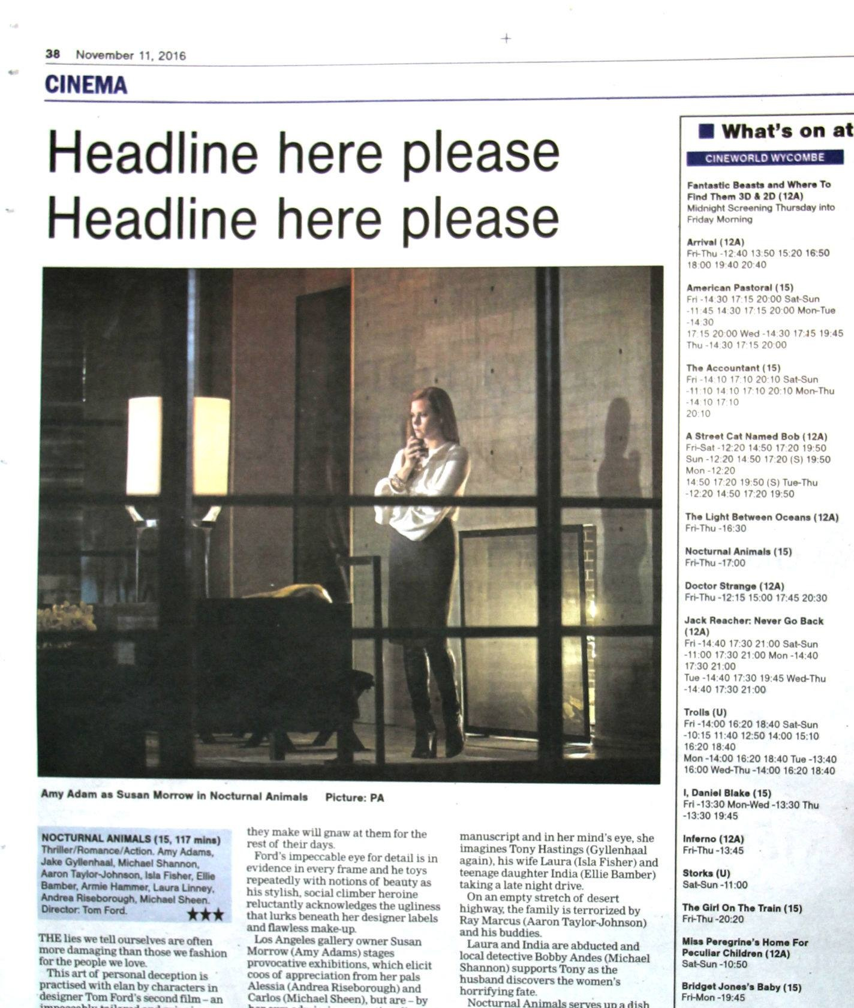
The Accidental Advisor
• Invited at to NYIT for a banquet
• Thought I’d meet an investor for my magazine
• Instead restarted my teaching career
•”Do you want to be responsible for every typo?”

Slide 10
Then about 2 years later….
In the middle of teaching a JOUR 101 course, I get a call from the chair. “You have your newspaper.”
A new dean of College Arts & Sciences, a former AP reporter and journalism prof., had the same question I did when he was hired.
He’s James Simon, who urged me to attend CMA last spring and “learn how to become an adviser.”

Slide 11
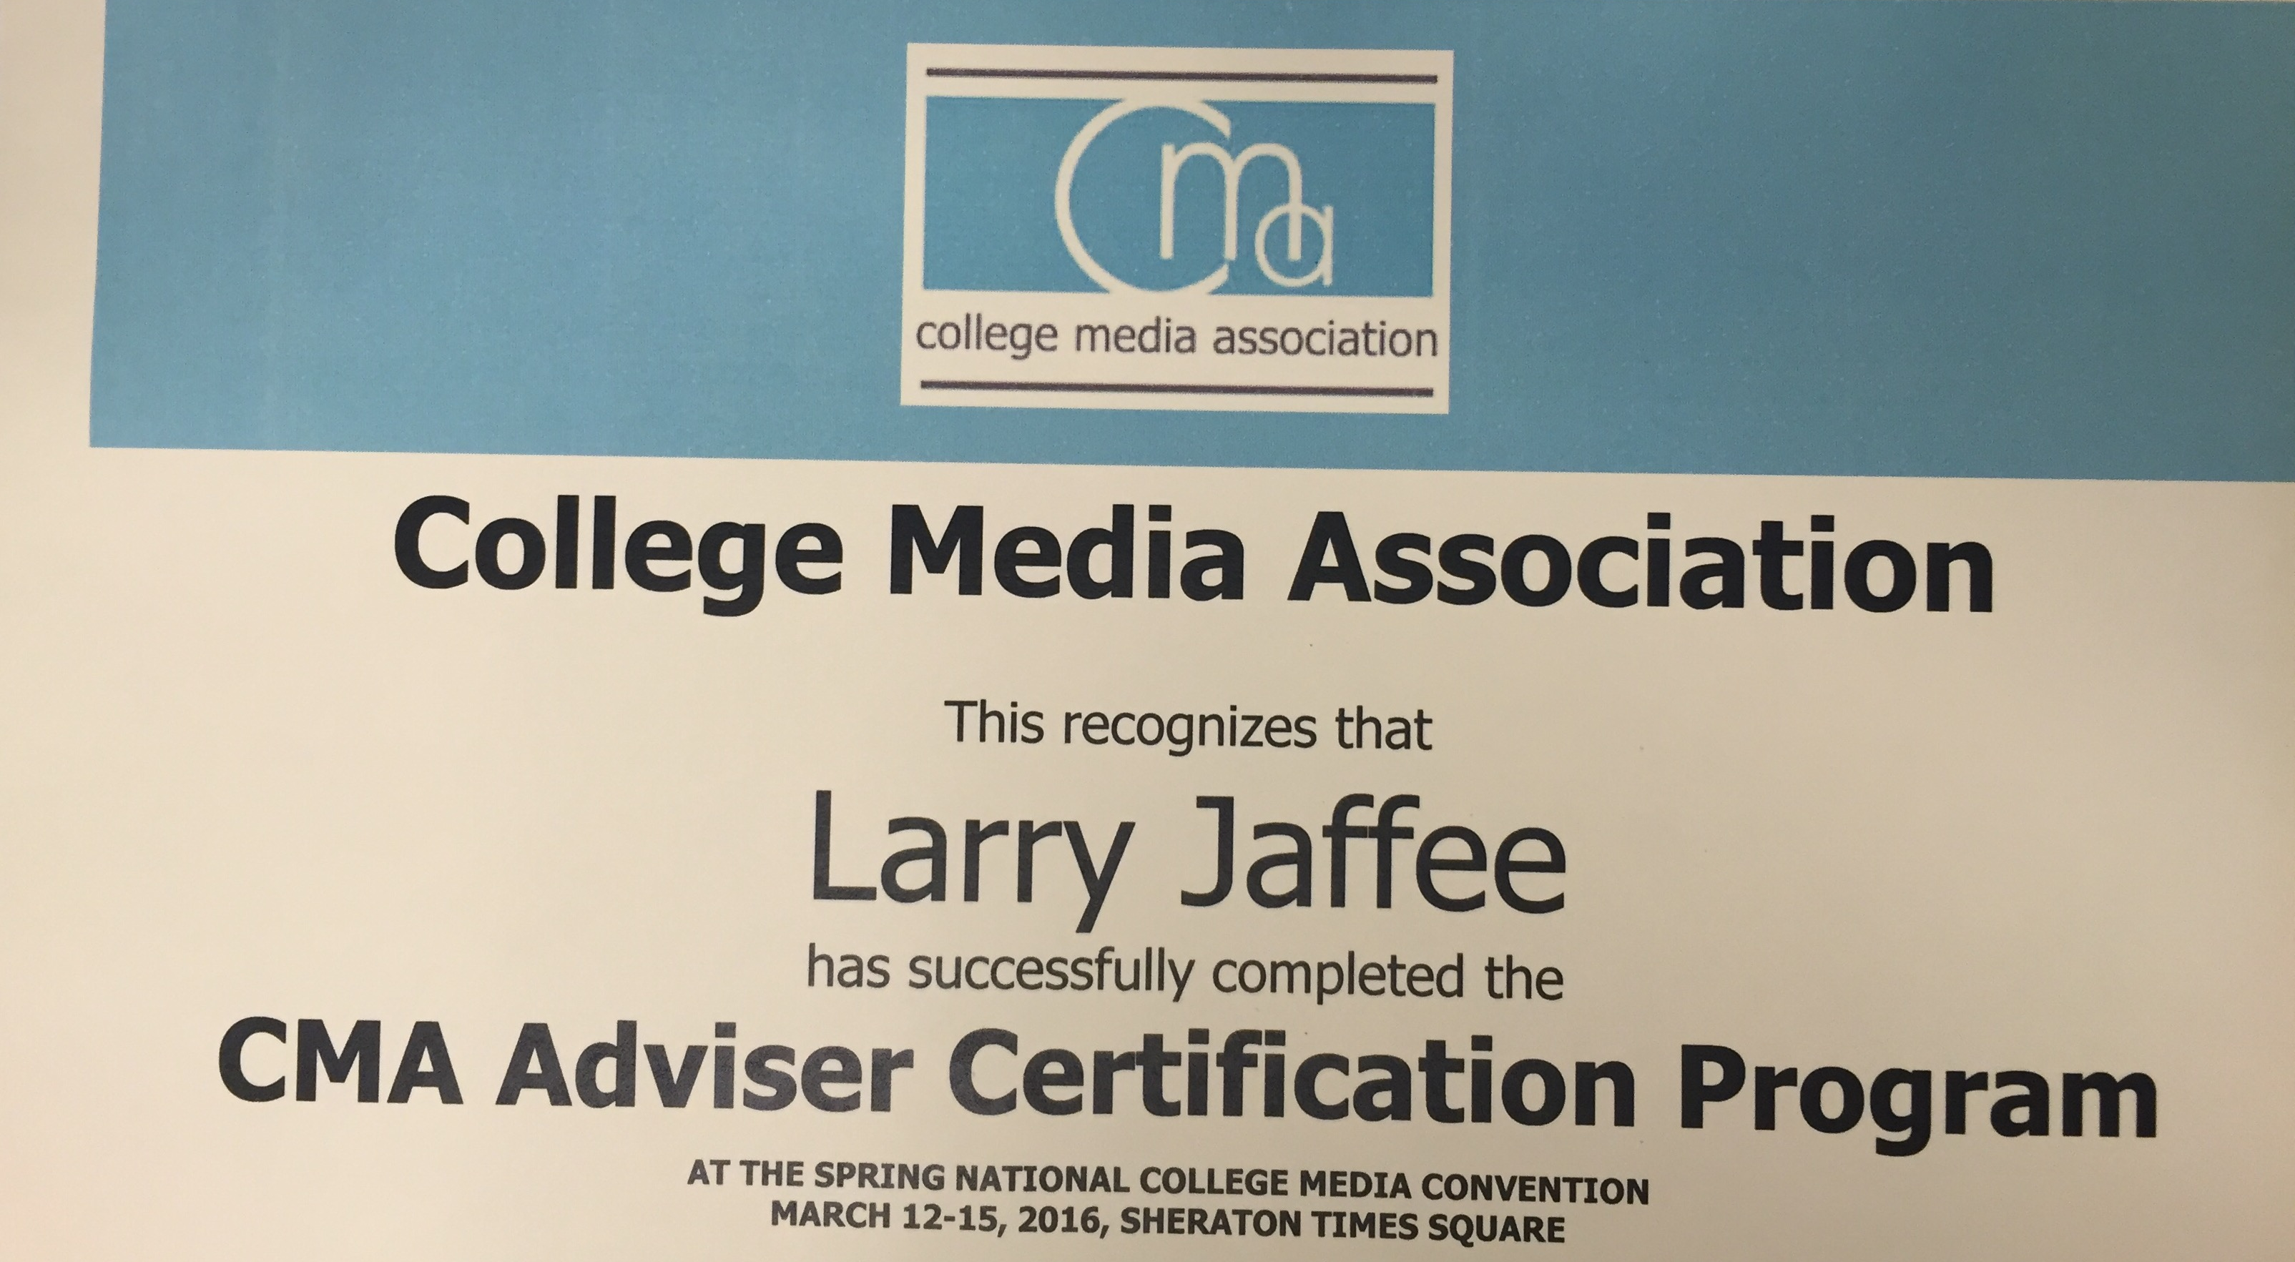
Adviser Track Proved Invaluable

Slide 12
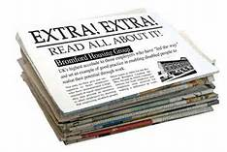
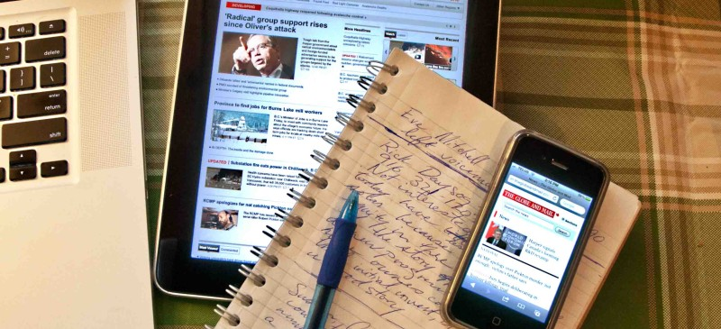
Print or Digital?
• Newspaper favored by 2:1 margin over a digital publication in my JOUR 101 class; now if I could get them to read one

Slide 13

My Goal: These Students

Slide 14
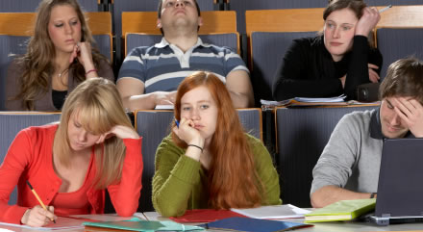
The Very Real Possibility

Slide 15
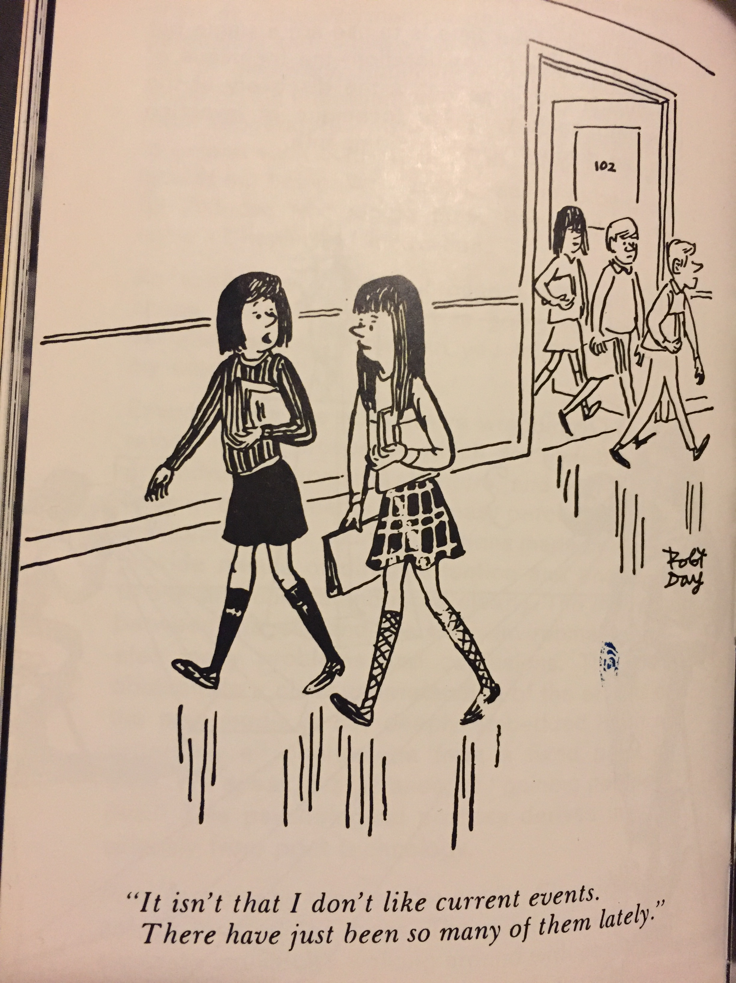
Are these your journalism students?

Slide 16
My Concern: Enough Interest?
I had 2 JOUR 101 classes canceled in 2014 & 2016 because of low enrollment
Then how am I going to staff a newspaper?
NYIT’s Comm Arts department focus had been on video production
Media literacy among most students not good
New York Times pulled its free daily papers because they weren’t be picked up
Half the Manhattan student population are international (probably don’t read English newspapers) and get news from home online

Slide 17
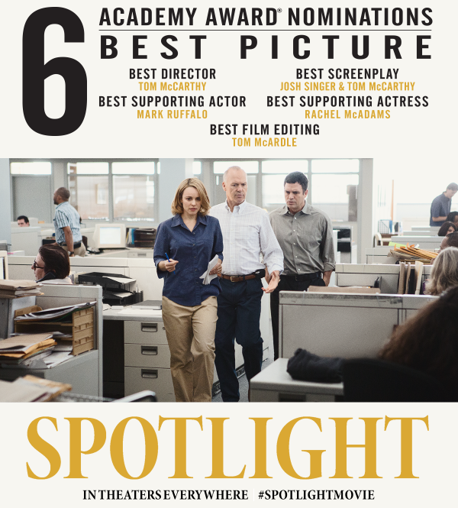
What to call it?
• NEWSPAPERS ARE
COOL AGAIN!
• NYIT’S STUDENT NEWSPAPER
IS COMING IN THE FALL
• THE NEWSPAPER IS OPEN
TO UNDERGRADUATES
& GRAD STUDENTS
• WE NEED: EDITORS,
REPORTERS, COPY
EDITORS, DESKTOP
PUBLISHERS, DESIGNERS,
PHOTOGRAPHERS,
VIDEOGRAPHERS,
WEBSITE CREATORS,
SOCIAL MEDIA MAVENS

Slide 18
A Chinese grad student Jing with newspaper experience:
Saw my rush job of a poster and offered to make a better one (below), and also wanted to become production editor

Slide 19
A ‘Newspaper Lab’ Creation
After a few Spring semester meetings with the dean, it’s determined:
The new publication would be produced out of a “Newspaper Lab” class that will meet once a week for three hours
It’ll be funded by the Student Government Association
The goal would be to publish 3 issues a semester

Slide 20
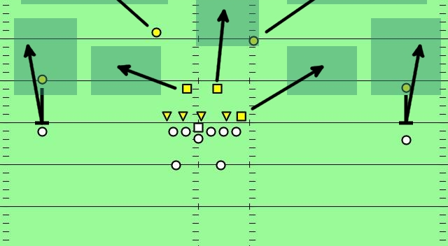
Game Plan: Get Buy-Ins

Slide 21
Make the rounds at both campuses
Meet with key faculty and administrators
English department chair to find copy editor/s, writers – mixed results
Great support from other campus adviser, who provides welcomed periodic pep talks
School not known for inter-disciplinary cooperation (i.e., silo mentality)
CFO who brought me in loved the idea of the newspaper, and felt it was needed
Suggested other key buy-ins, such as student affairs administrators, legal, SGA

Slide 22
Advised to “Avoid Controversy”
I explained my main takeaways from CMA16 was “no prior review” or “prior restraint”
I emphasized that the Students were going to decide the content, not me
I’m not the editor, but will answer their questions; hopefully, they’ll have them
Besides, the University’s liabilities – if it were sued – would greatly increase if I were deciding content as the adviser

Slide 23
Staffing concerns
Who’s going to be editor?
I learned my best 2015 journalism student – everything she wrote for class was good enough to be published professionally – was not interested in becoming editor because she had to work and she couldn’t commit to time required, but she would write for it
Photo editor/grad student, recommended
Copy editor, son of OW adviser, transferring

Slide 24
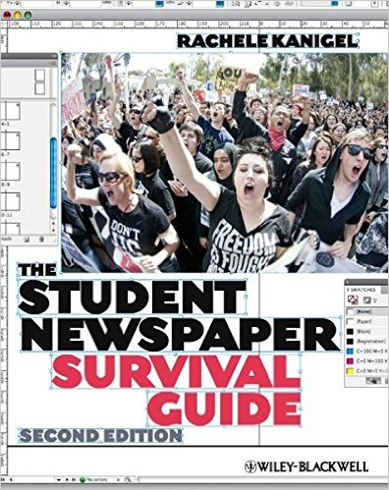
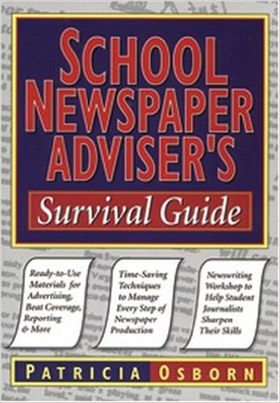
Bought Two Books in late May
One for the staff; one for me

Slide 25
By early June, green light
Class roster filled up with 18 students
About half undergraduate; half grad students
Only 4 were previous students of mine (2 advg.)
It’s really happening: Set priorities, agenda, budget
Dean suggests name: Manhattan Slate (to synch with Old Westbury); I diplomatically respond that the students should name the publication

Slide 26
Budget: Ask for more – use it or lose it
My corporate background working at magazine publishers served well
Dean of Student Affairs wanted a student business manager to set the budget
June 2 memo: I explain the class is not in session so I’ll have to figure it out
Asked for $10K, figuring it would be cut in half; it was. Able to work with $5K (budget helped pay for CMA for about 9 of my students)
Already used a commercial printer for my own paper (Slate published on-campus, a concern)

Slide 27

First Class 9/13/16: Simply Magical

Slide 28
Wish there was a film crew
Knew we couldn’t waste any time
Assign jobs, pick name
Passed around big index cards in which I asked each student to write about their background, previous journalism experience
Where they’re from; what job they want and why they’re qualified – went around room
Within a half hour, it came together

Slide 29
Two Co-Editors Emerged
Solid JOUR 101 student from last year
The other wrote on her card she was a junior who created and edits an online magazine for college students: AluAliya.com, to which the other student was already a contributor
That night I check out her site thoroughly
She doesn’t need my help as far as creating an online publication

Slide 30
Voting on a Name, an Aha Moment
As previously mentioned, Dean wanted “Manhattan Slate”
Also on table: “Manhattan Spotlight”, but not thrilled; the movie was already old news
Open to suggestions; nothing emerges. We start voting. Frowns all around.
A hand goes up: “I have an idea: the Manhattan Globe,” We all agree: It’s perfect. Editors from 6 countries, she’s from Sri Lanka

Slide 31
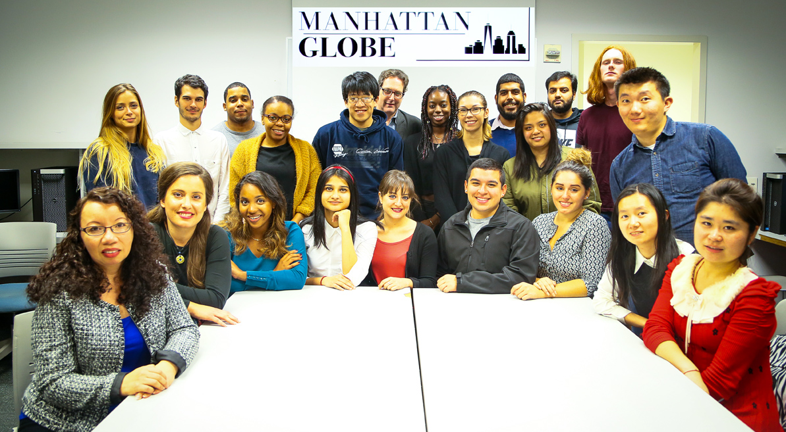
Class 2: Staff photo, logo

Slide 32
Setting Up Beats, Off/On-campus
Mission Statement –stresses their independence & voice of students
Co-editor suggests a dedicated Slack channel, a private means of communicating off NYIT servers – I love it, of course.
Marketing campaign, social media presences on Facebook, Twitter, Instagram
No sports team on Manhattan campus

Slide 33
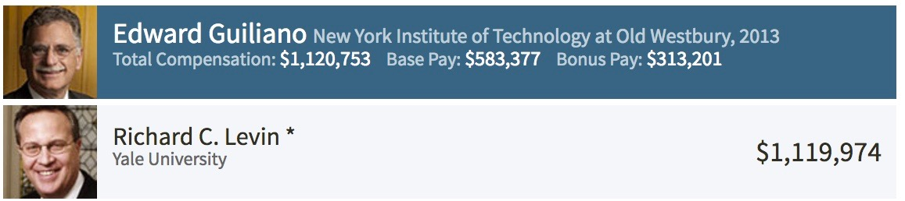
“He Makes How Much!?!”
Chronicle of Higher Education ranks private college presidents by salary; NYIT #13 at $1.2 million ahead of Yale and Harvard
I consult via email with CMA president whether it’s ok for me to tip them off; it is
.

Slide 34
Very next morning, faculty memo
President Guiliano has resigned after 17 years
Students weren’t told this news, reinforcing why this newspaper is needed
Forward email to editors; they agree – Story On!
Set up an exclusive interview with president
Head of PR sits in on interview, tells the co-editors “Here’s a chance for you to put NYIT in a really good light”

Slide 35
We set up copy-flow system, but…
Some of non-edited articles get printed
We had discussed the need to follow a stylebook
Four copy editors
Not sure if managing editor understands what I mean by staggered deadlines, so all the copy isn’t coming in at same time
Explain file-name system; honestly still not sure if they get it, but mistakes fewer

Slide 36

Production Editor at Breaking Point

Slide 37
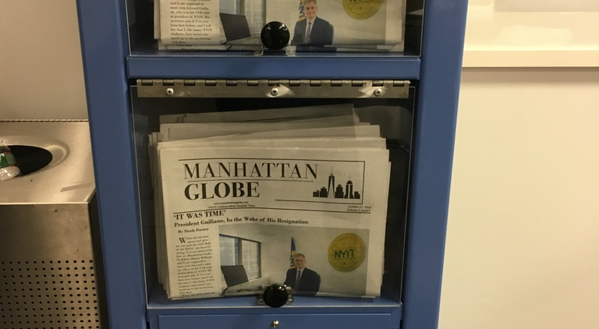
First issue Published Oct. 17, 2016
Kiosks courtesy of Signal, initial contact CMA 16

Slide 38
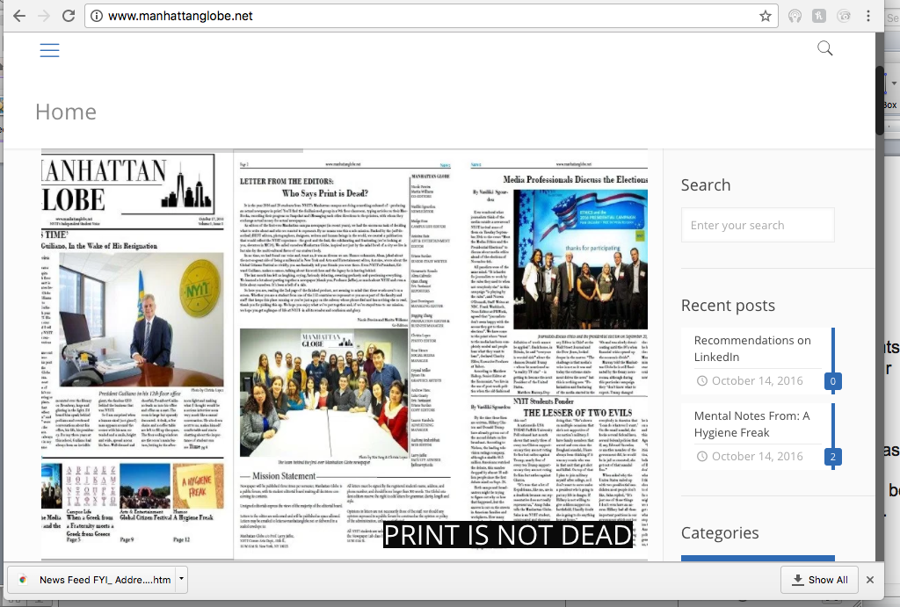
Simultaneously Put Up a Website
Maintenance turned out to be an issue we’re still grappling with

Slide 39
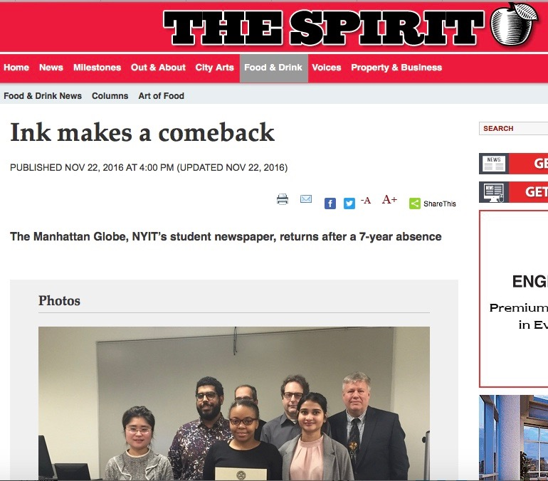
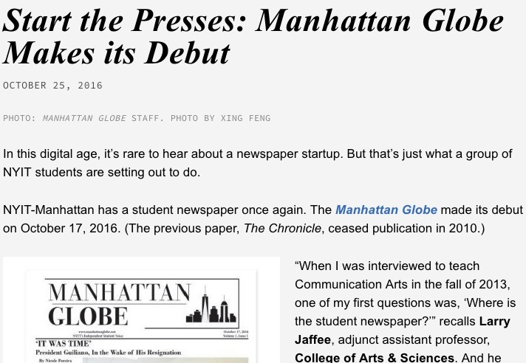
The Globe Gets Some Recognition

Slide 40
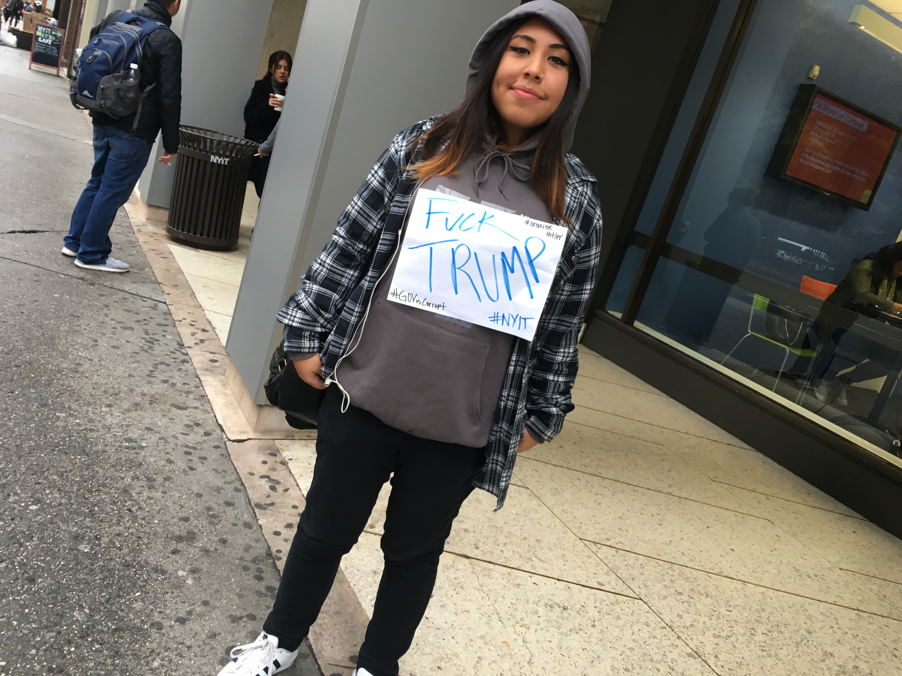
The morning after the election
The co-editor texts me this photo she took; I’m about to start a class at my other school

Slide 41
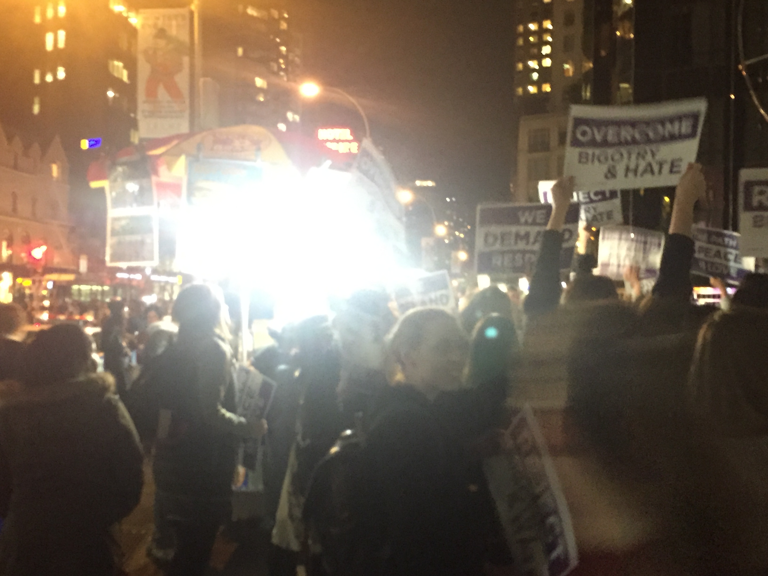
NYIT Across from Trump Hotel

Slide 42
Questions about the Protester
Did the student know you were the co-editor of the paper and the photo could be published?
Do you know her name?
Time of the essence, I consult with the department chair from my other school, and put the Student Law Press Center on speed dial
Meanwhile, we’re planning a launch party, coinciding with establishing a chapter of the Society of Collegiate Journalists

Slide 43
Issue #2 finally published Nov. 23
• Didn’t know what to expect
• First person who grabbed a copy as it was get delivered was former Dean, who said “I don’t agree with this.”

Slide 44
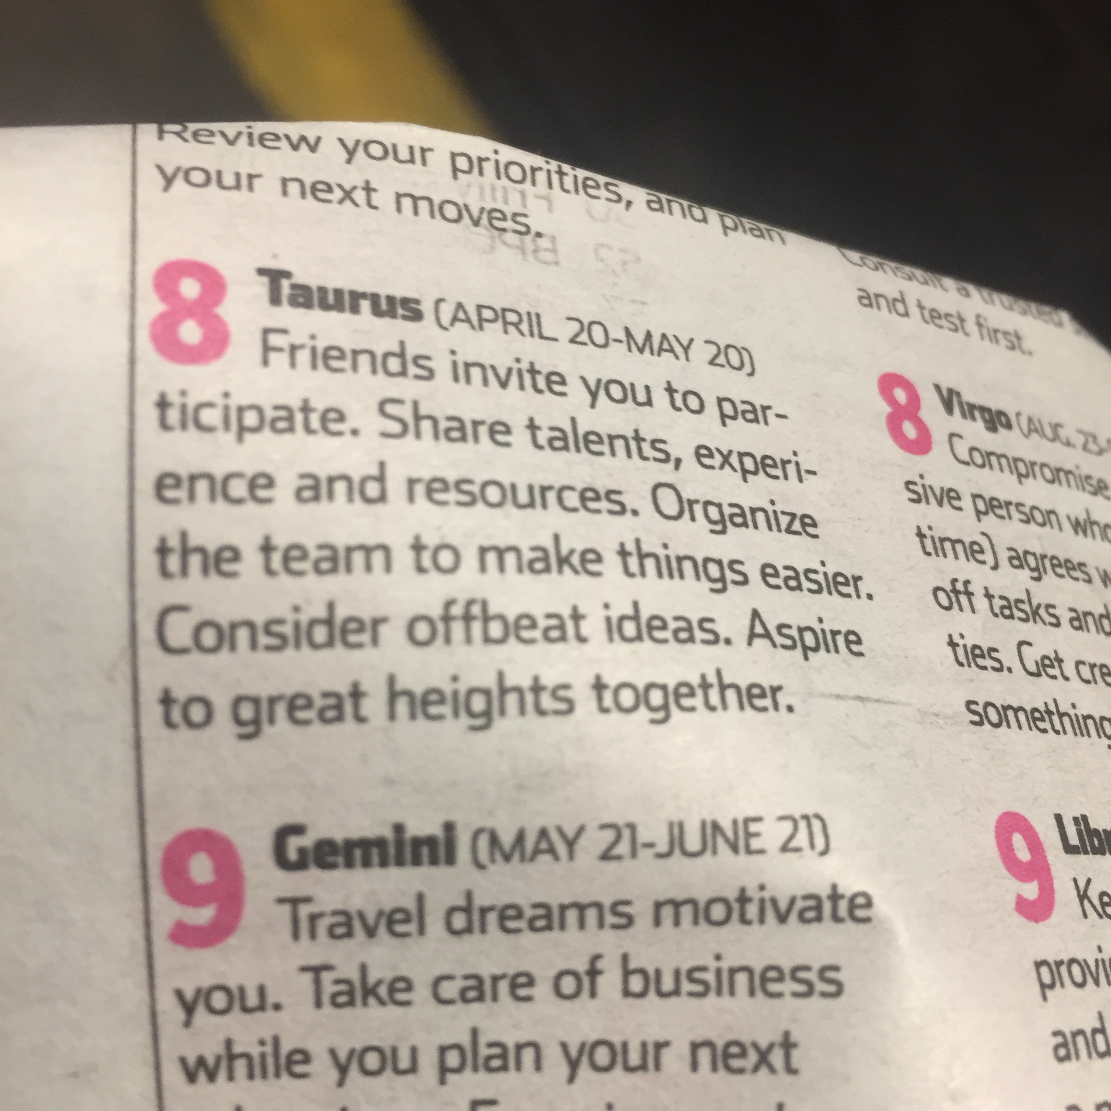
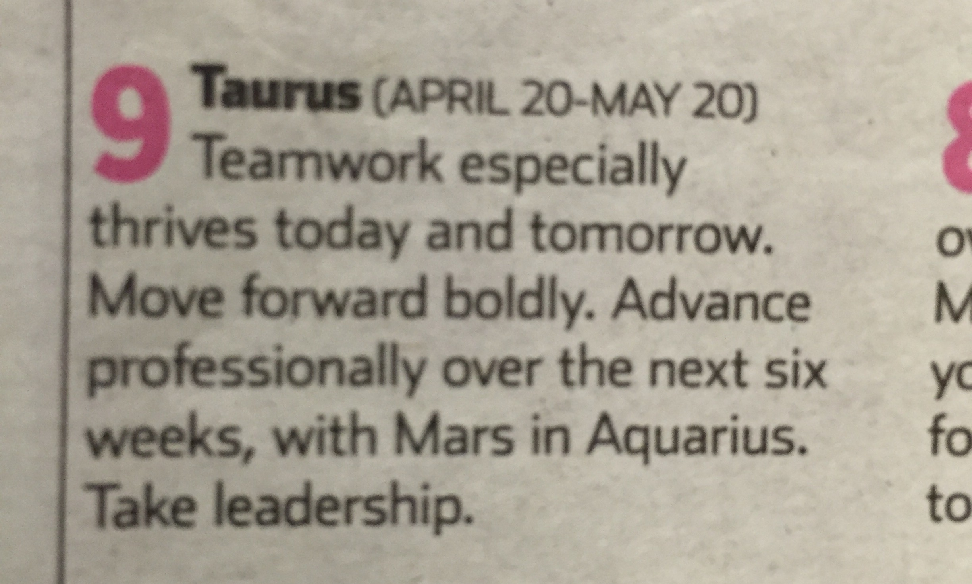
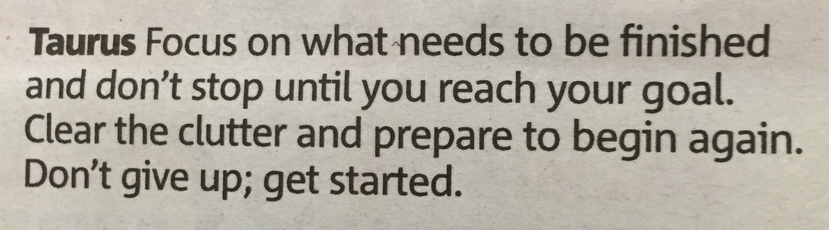
Motivation tactics

Slide 45
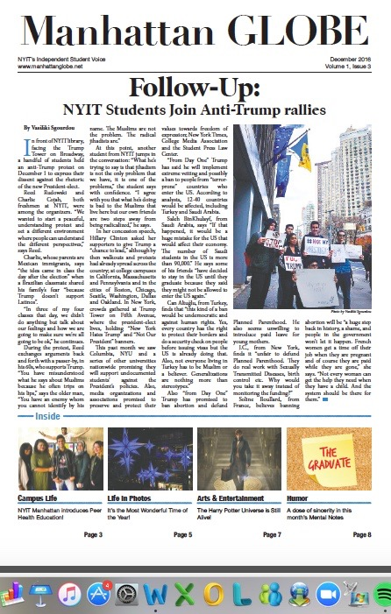
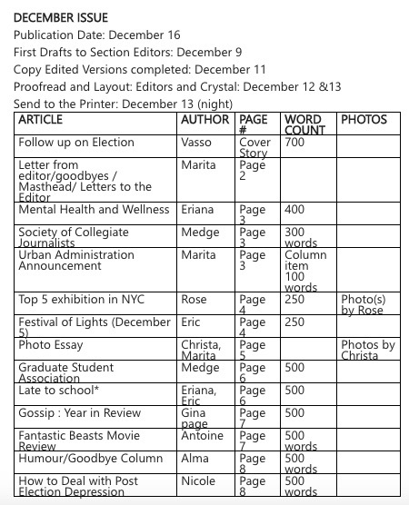
Issue #3: akin to childbirth
Finals week, senioritis, 6 staff graduating

Slide 46
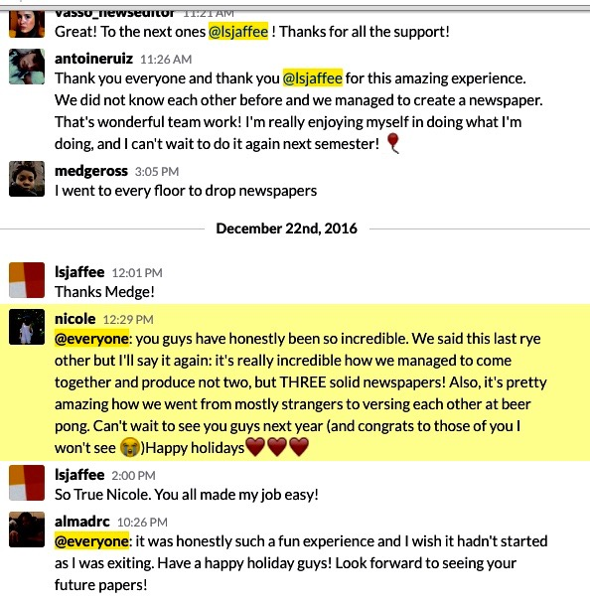
From strangers to beer bong…

Slide 47
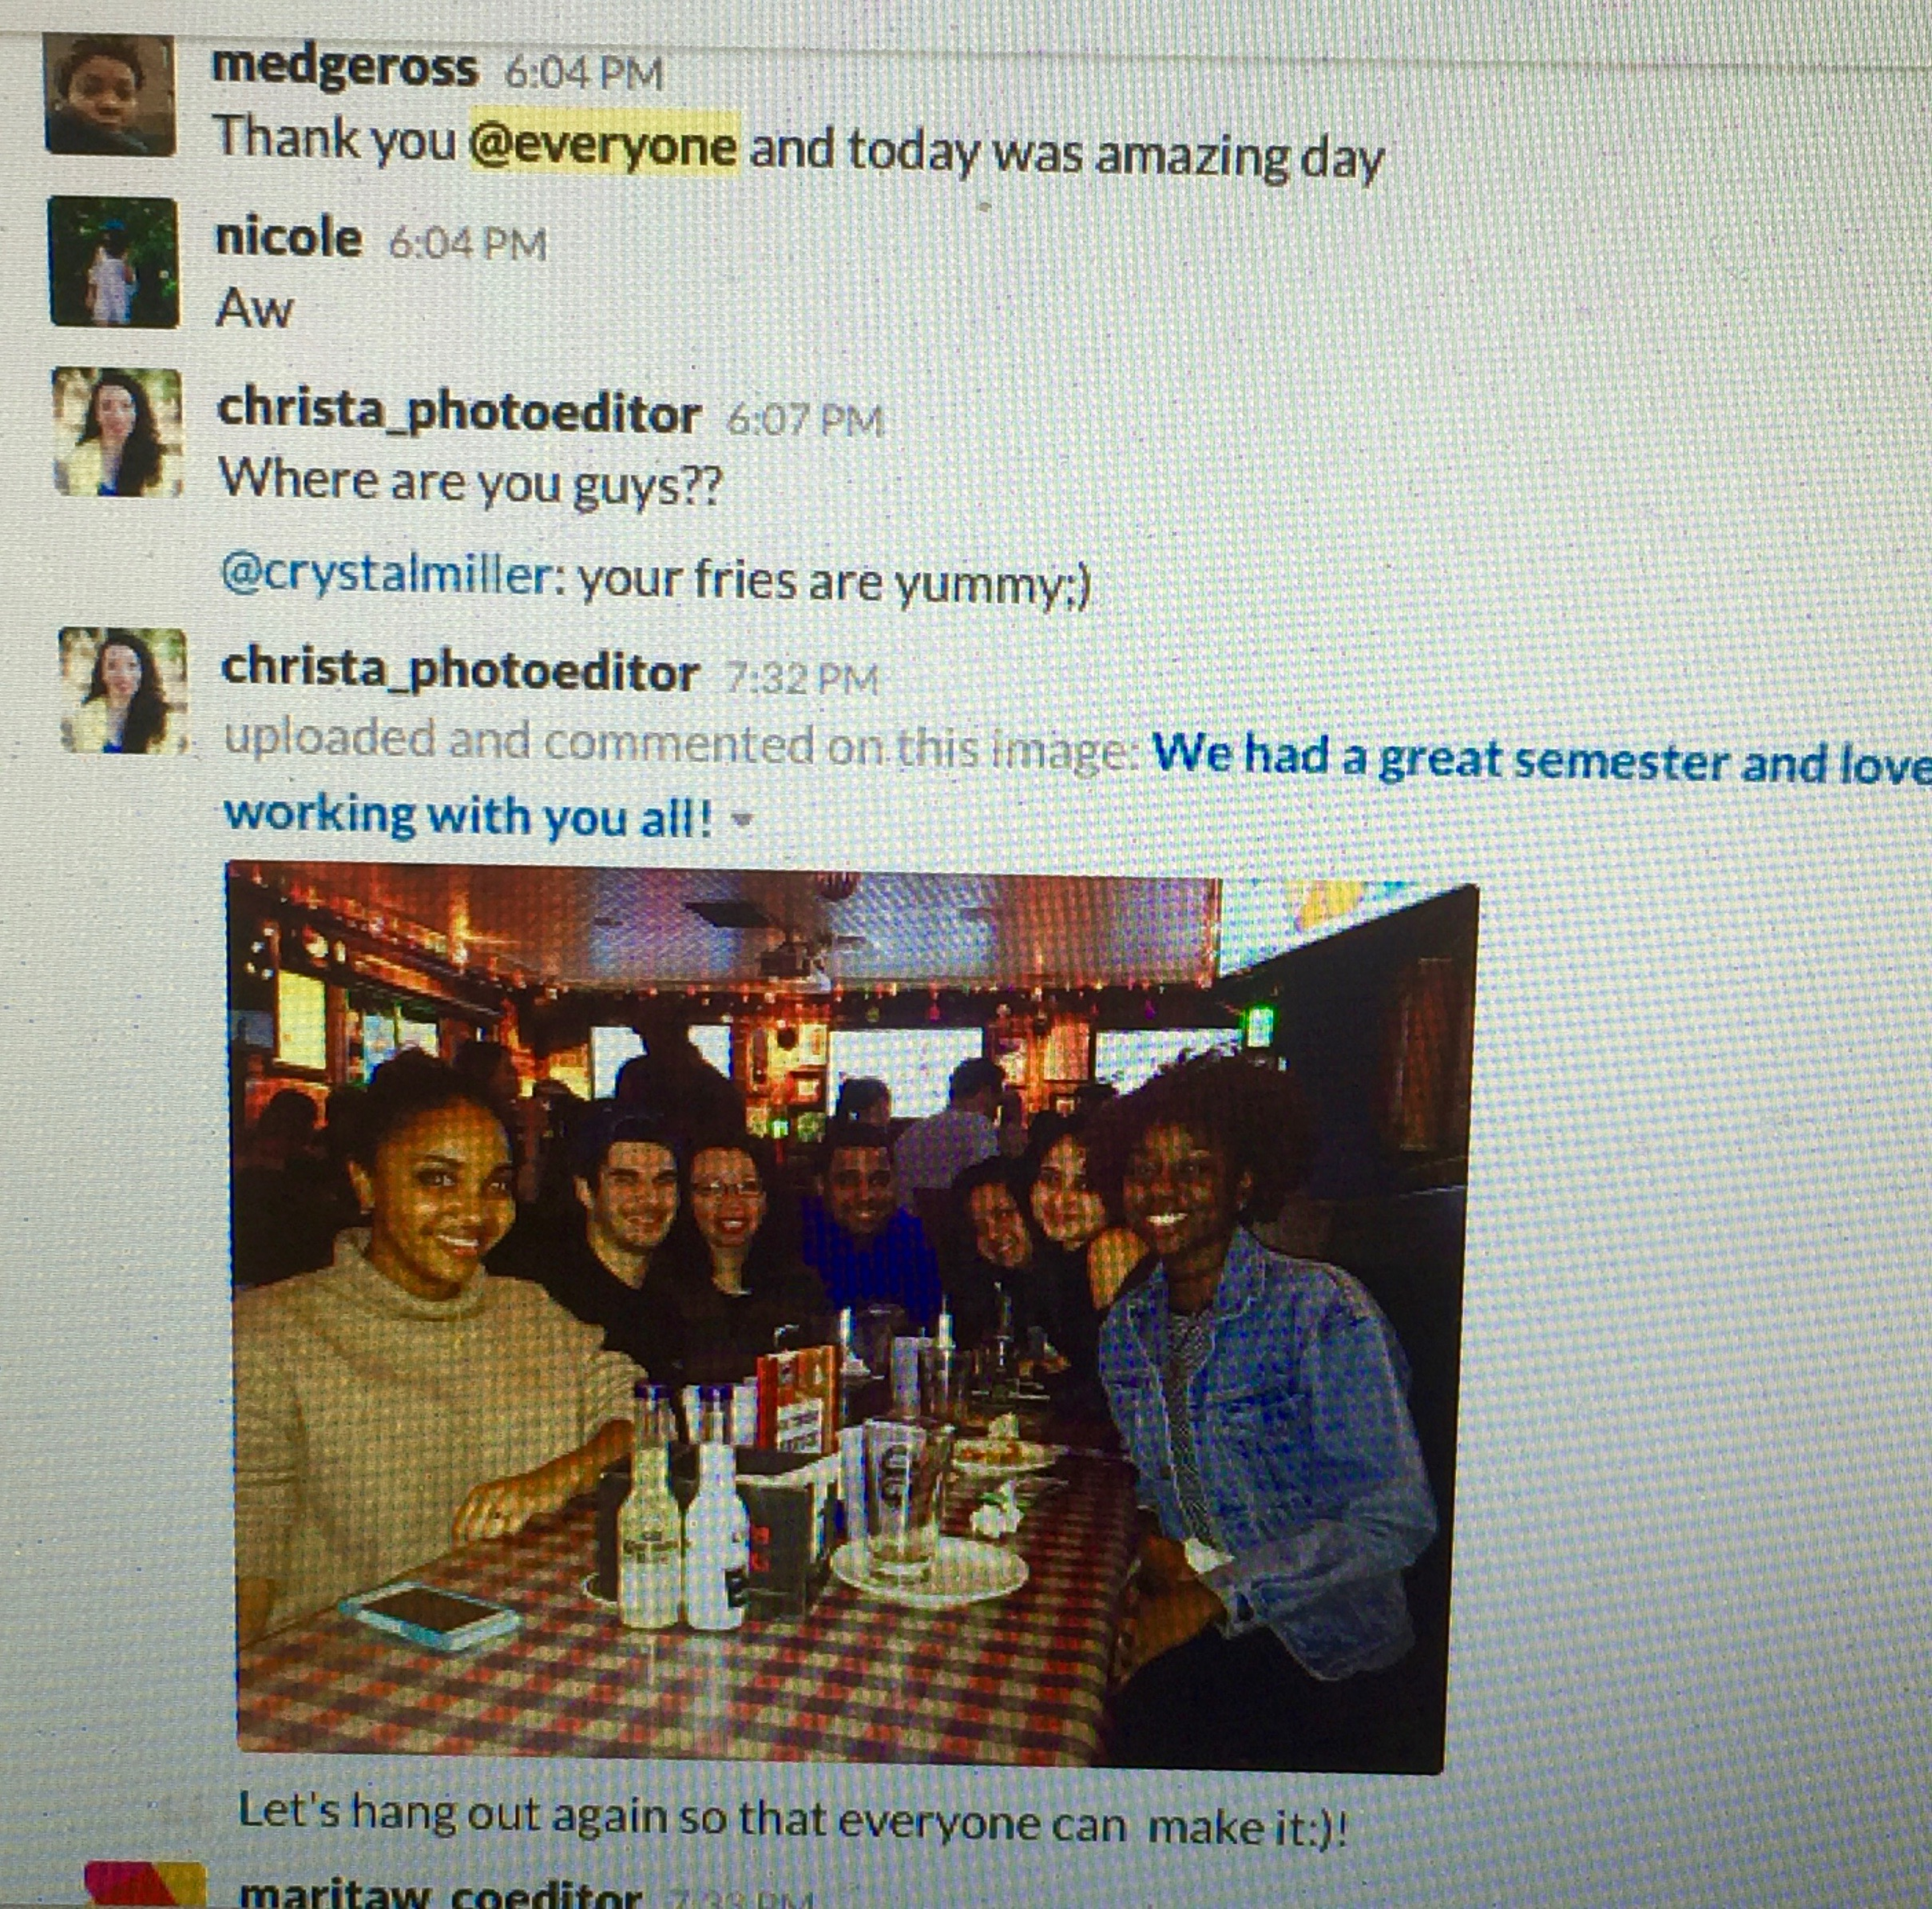
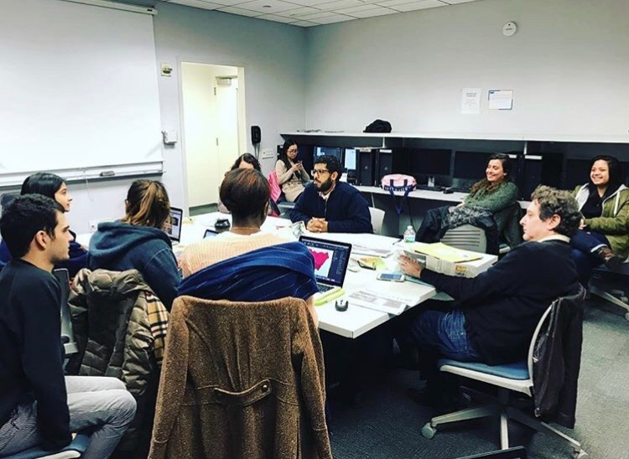
Mission Accomplished: 3 issues
Staff camaraderie; reminds me of my Hofstra Chronicle experience nearly 40 years ago

Slide 48
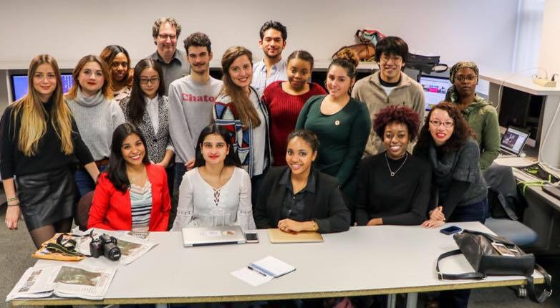
Manhattan Globe, v.2
Half of the staff is new second semester; key initial positions intact, joined by new writing, design, website and advertising talent. Increased diversity from Jamaica and Saudi Arabia.

Slide 49
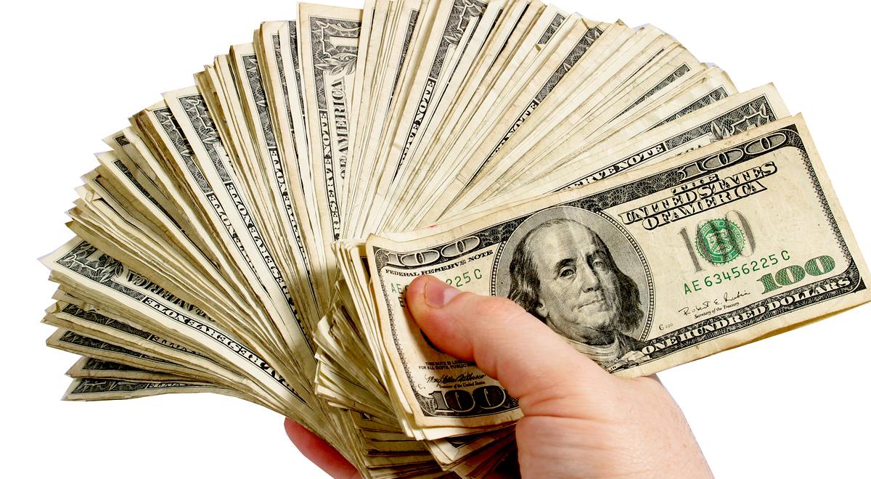
Funding the Beast

Slide 50
Round Two
After every issue, I give a detailed critique, post on the Class Blackboard
Department gave me a course for next semester called Digital Storytelling, designed to help create multimedia content for Manhattan Globe
In May, nearly entire staff graduating
Stay tuned….

Slide 51
Questions, comments?
Larry Jaffee, adjunct assistant professor,
New York Institute of Technology
Adviser, Manhattan Globe
ljaffee@nyit.edu
917-291-2488

